Slide 1
Welcome to CS10 Group First Meeting
Team member
Wilma Liu
Fiona Hu
Pat Zhang
Elvia Tong
Reehaa Ding
William Quan

Slide 2
About us
Master of Data Science students in Sydney University
Bachelor of Computer Science, Software Engineering, Information System, Business Analytics and so on.
Technical, Collaborative, and Passionate.

Slide 3












About us
Wilma Fiona Pat Elvia Reehaa William
Country Road
L. James
Erling Haaland
Glass animals
King Gnu
Hitorie

Slide 4
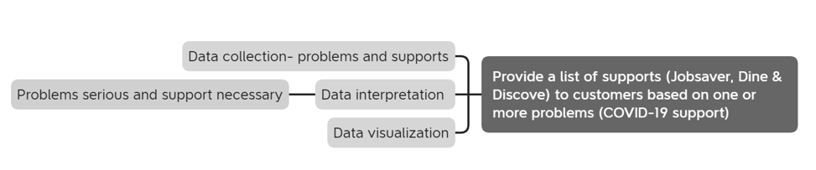
1. What kind of support on what problems
Problem Statement and Possible Solutions
How many problems should we focus on?
Is this possible that two problems might be correlated to each other?

Slide 5
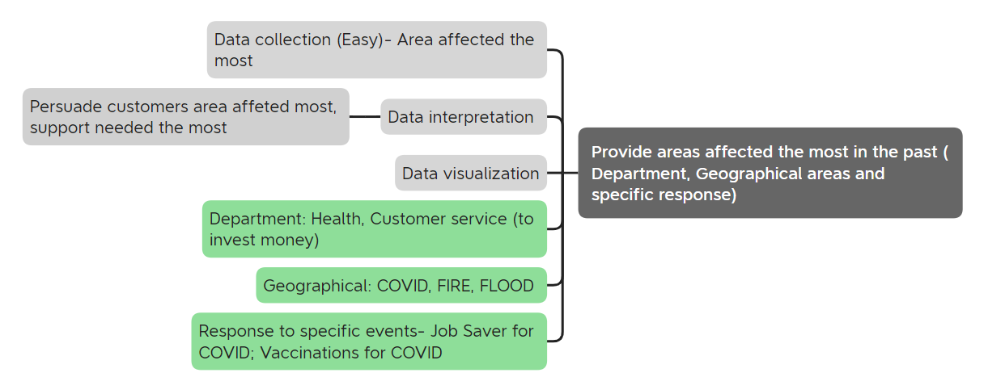
2. Area support most needed or effective
Specific solutions- By Departments, Geographical areas and Responses

Slide 6
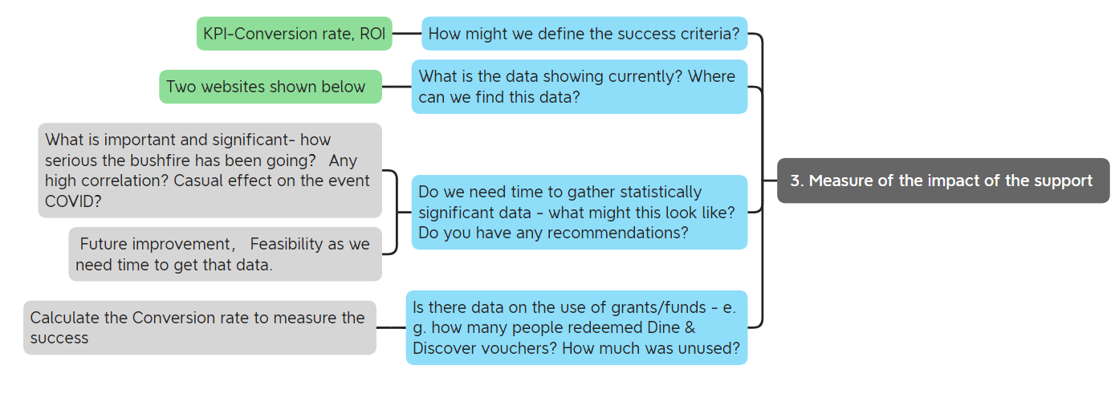
3. Measure of the support

Slide 7
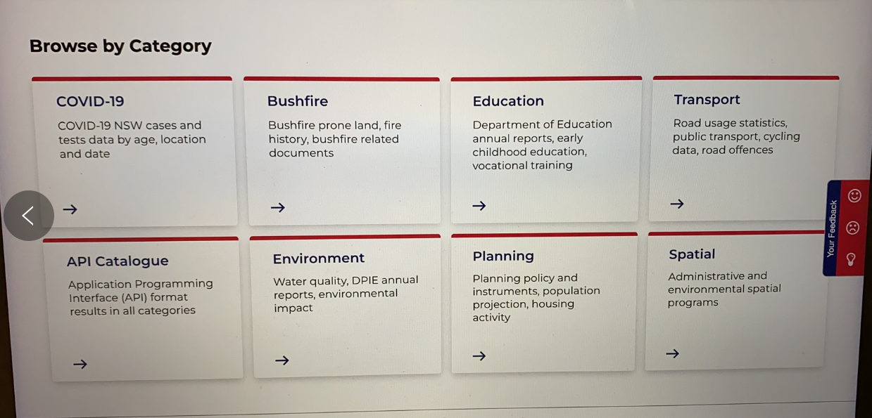

Slide 8
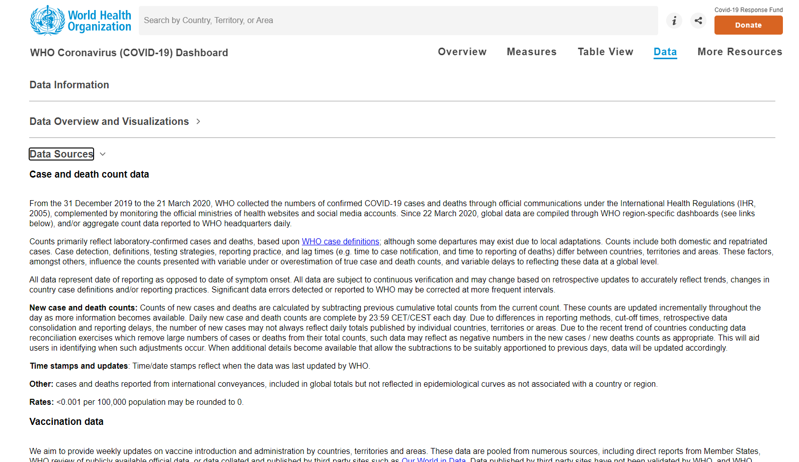

Slide 9
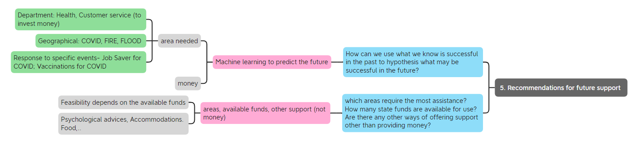
4. Recommendations

Slide 10
Thank you !

